Slide 1
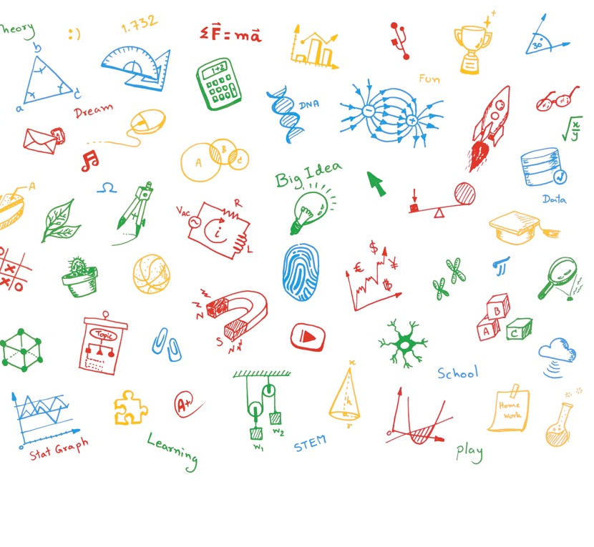

Looking for superheroes
Do something amazing
– Be an engineer!

Slide 2

Looking for
superheroes!
Planet cleaner
Star maker
Robot ruler
Matter shaper
Time traveller
Problem Solver!
PRIMARY SCHOOL
Notes:
Your aim: inspire kids about the big-picture of why engineering matters, and how engineers shape the future...without using the word ‘engineering’ in this slide.
(Choose an application of engineering, and describe the person who does this without saying ‘engineer’, e.g.)
Improving the environment
Building roads, bridges and skyscrapers
Inventing a sustainable future
How do you get there? Enjoy learning about:
How things work
How to make things
Be a good problem solver

Slide 3
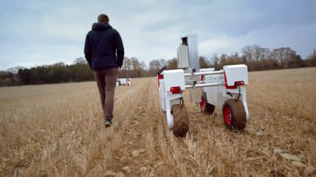
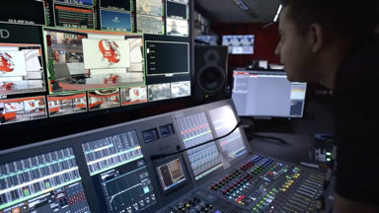
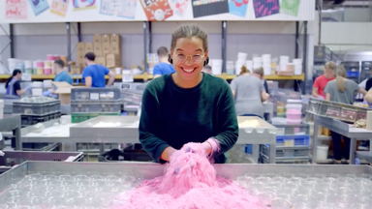

Do you know
a superhero?
PRIMARY SCHOOL
Notes:
Your aim: illustrate how engineering touches modern-day life.
(Depending on your available time and your interests, you could choose one or more of these to talk about.)
Did you know that engineering is everywhere? From the games you play to the smells you sniff - engineers help to change the world.
Examples:
Lego
<video Robot maker>
0:40
TV
<video BBC TV engineer>
0:40
Fragrances
<video Fragrance Finder>
0:40
We call those who use their learned skills to solve problems ‘engineers’ – they’re like quiet superheroes no one hears about.
There are many kinds of engineers.
Engineers bring us most things we enjoy today.

Slide 4
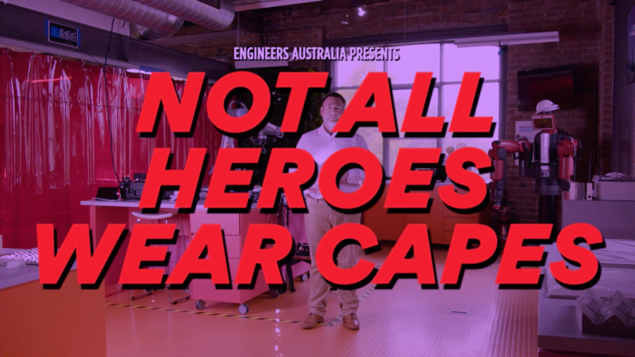
You can be
a superhero!
Pick a problem > find the answers > get people to help you
PRIMARY SCHOOL
Notes:
Your aim: connect engineering disciplines with real-life problems (and their answers) that could shape the future.
There are people who work every day on solving some pretty big problems, like:
how to grow gold on trees
reverse-engineering butterflies
building the world’s largest 3D printer
<video 1:04 >
(if you have a practical example in your discipline, you could also use this to personalise the presentation)
Point out that:
Problem solvers learn a set of skills we call ‘engineering’
It takes great team to bring a project to life
You start learning how to do this at school
Eg:
Grow gold on trees = chemical engineering
Recycling plastic = chemical and mechanical engineering
Building a skyscraper = civil and mechanical engineering
There are 3 simple steps to changing the world:
Pick a problem
Work out the answers
Get people to help you
The takeaway - maths, science and technology subjects are the pathway to solving these problems.

Slide 5


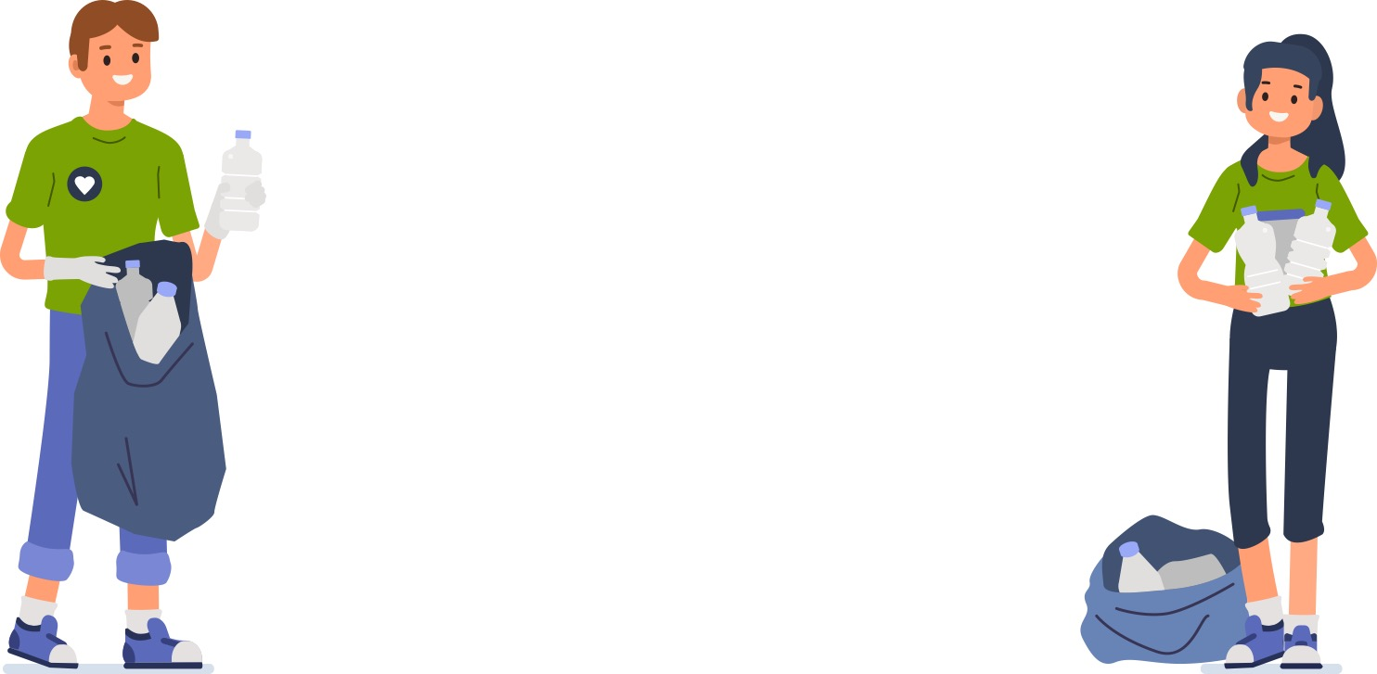
Solving crazy
problems with
crazy ideas
PRIMARY SCHOOL
Notes:
Your aim: introduce the videos one at a time, then generate some interaction.
(Depending upon audience size and age, ask for ideas, then talk about the ideas’ possible problems and ways to solve them, etc.)
Engineering superheroes solve problems.
Let’s think about:
finding a new way to recycle plastic?
<video - Darren recycling plastic>
1:35
building a skyscraper that reaches right into space?
<video - Isabel shaping matter>
1:00

Slide 6

Choose your own
superhero adventure!
There are plenty of ways to change the world, but where do you start, and what can you do right now?
STARportal
This site is full of free and low-cost STEM activities. Log on and discover a world of online and home-based activities to spark your curiosity. starportal.edu.au
Shell Questacon Science Circus
A free, lively and energetic science show that visits schools across Australia. Would your school like to bring the show to its students?
questacon.edu.au/outreach/programs/science-circus/schools-and-teachers/science-circus-incursions
EA Junior Club
Find lots of fun and informative engineering activities and resources that help students apply their science knowledge in class and at home.
EAJuniorClublinkTBC
PRIMARY SCHOOL
Notes:
Wrap-up time. Discuss how students can get involved.
Encourage attendance and interest in class and engineering-related subjects like maths and science
Encourage self-motivated research and learning (resources for this featured on the slide)
Encourage kids to start thinking about ways to solve problems now;
as an example, leave them with an inspirational video on how to be an inventor (next slide).

Slide 7
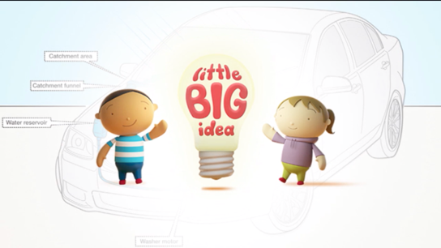
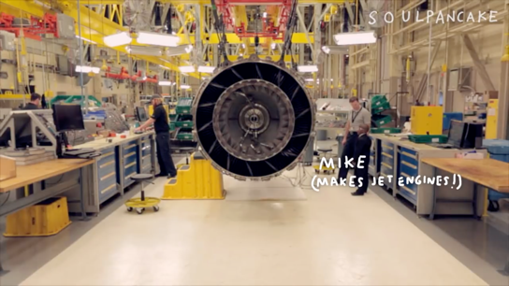
Choose your own
superhero adventure!
PRIMARY SCHOOL
Notes:
Leave them with an inspirational video on how to be an inventor!
<Little Big Idea Winners> (Aus version)
2:34
or
<How to be an inventor> (US version)
4:59

Slide 8
