Slide 1

Guiding Future
Fire Safety Engineering
Practice
Stephen Grubits
Notes:
1

Slide 2
Outline
Reflection on FCRC and existing guidelines
Reflections on current practice
Trends in engineering and building design
Risk-based Fire Safety Design Code
Reflections on the environment
A vision for the future guidelines
Turning a vision into reality
Notes:
2

Slide 3
Fire Code Reform Background
Six year ambitious program of research
Joint venture between government, industry and researchers
$13M funding from government and industry
Development of both the deemed-to-satisfy and the performance aspects
Advocated Risk Assessment approach
Development of risk methodology
Fire Engineering Guidelines for the interim

Slide 4
Fire Code Reform Objectives
For all classes of building occupancy:
Establish a scientific foundation for safety requirements and develop additional design solutions
Introduce a risk assessment methodology and performance assessment into the fire safety requirements
Development of a comprehensive fire safety design code

Slide 5
Fire Code Reform Program
Comprehensive program of 7 projects:
  Project 1. - Performance Regulation Framework
  Project 2. - Fire Performance of Materials
  Project 3. - Fire Resistance and Non-Combustibility
  Project 4. - Fire Safety Risk Engineering Models
  Project 5a.- Fire Engineering Guidelines
  Project 5b.- Fire Safety Design Code
  Project 6. - Low-rise Shopping Centre Fire Safety

Slide 6
FCRC Project 5a
Fire Engineering Guidelines
Split from Project 5 to provide an interim document until risk-based code can be adopted
Recognised both deterministic and probabilistic analysis
Pioneering document internationally setting the framework for performance-based design
Recognised importance of FEB to setting benchmark
Few warts, some have been ironed out
Arguably too successful as it relieved pressure for risk-based code

Slide 7
Life of an Interim Standard?
What should be life of a standard that was only ever intended to have a life of a few years?
3 years, 5 years, 7 years maybe 10 years?
Is 20 years (and counting) too long?
The Fire Engineering Guidelines was first published in 1995 and revised in 2001 and 2005
Intended to be an interim document until risk-based Code was published
Unfortunately work on the risk-based Code ceased in 1997 and never resumed.

Slide 8
FCRC Project 5b
Fire Safety Design Code
Initial scope of this was defined in Building Regulations Review Taskforce report in 1990!
Was to be based upon risk methodology developed through Project 4
Acceptability of risk to be based upon harmonized risk of deemed-to-satisfy provisions
Monte Carlo simulation of a wide range of fire scenarios
Recognised need for reliability and fire statistics data

Slide 9
Fire Safety Design Code
1 | SCOPE AND GENERAL | Preliminaries
2 | MATERIALS AND COMPONENTS | Preliminaries
3 | BUILDING FIRE SAFETY SYSTEM REQUIREMENTS | Overall requirements
4 | BUILDING CHARACTERISATION | Overall requirements
5 | OCCUPANT CLASSIFICATION AND RATING | Overall requirements
6 | FIRE INITIATION AND DEVELOPMENT | Fire in enclosure of origin
7 | SPREAD OF SMOKE AND TOXIC PRODUCTS | Fire in other enclosures
8 | FLAME SPREAD | Fire in other enclosures
9 | OCCUPANT COMMUNICATION AND RESPONSE | Occupant reaction
10 | FIRE BRIGADE COMMUNICATION AND RESPONSE | Fire brigade intervention
11 | OCCUPANT AVOIDANCE | Occupant reaction
12 | CONSTRUCTION | Post design
13 | COMMISSIONING AND VERIFICATION | Post design
14 | OPERATION MAINTENANCE AND INSPECTION | Post design
15 | TESTING | Additional considerations
16 | EXISTING BUILDINGS | Additional considerations
Notes:
9

Slide 10






Current State of Fire Safety Engineering
Good progress in terms of adoption and market
Major projects use Fire Safety Engineering
Mostly “BAND-AID” FSE – fix DTS non-compliances
Mostly DETERMINISTIC analysis or OPINION
Educational courses readily available
ISO Fire Safety Engineering Standards
Significant International Developments
Risk methodology still not common!
FSE
Stephen’s Ball

Slide 11
Requirements of a performance-based approach to fire safety
CRITERION | ASSESSMENT
Performance must be clearly stated | NO
Performance must be measurable | Sometimes
Performance must not be subjective | NO
Required performance must be demonstrable | Sometimes
Measure of performance to be consistent | NO
Attainment of performance - after design | Usually
Attainment of performance - after construction | Sometimes
Attainment of performance – throughout life | NO
Role of FSE
Notes:
11

Slide 12
Drivers for Change
Community response to disasters
Ever increasing computing power
Ever increasing sophistication of programs
Price pressure
Greater automation
    repetitive jobs redundant – not just blue collar!
Trade agreements
    greater influx of products and building systems
Push for international standards for global market

Slide 13
Changing Context
ASPECT | LIKELY CANGE
Building Code | Greater emphasis on performance More Verification Methods More trade-offs for cost-effectiveness
Legislation | Responsive to community pressures Better quality and consumer protection
Trade | More FSE design done offshore Acceptance of foreign tested and approved systems Less reliance on Australian Standards
Technology | Greater automation of performance evaluation More sophisticated and integrated models
Engineering | Greater emphasis on risk More explicit (but automated) treatment of likelihood
Society | Greater aversion to risk – propensity for greater safety Adverse response to disasters

Slide 14
Engineering Trends
Integration of simulation into design
Fully tested virtual buildings prior to construction
Building simulation programs exist in many fields
Add-ins to AutoCAD and other design packages
    permit testing at design stage
Designs will be more and more object oriented
    Not just lines but representation of objects
Engineering will be done by software
Role of engineers changed to software developer

Slide 15
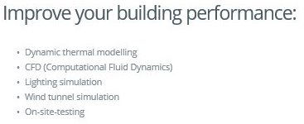
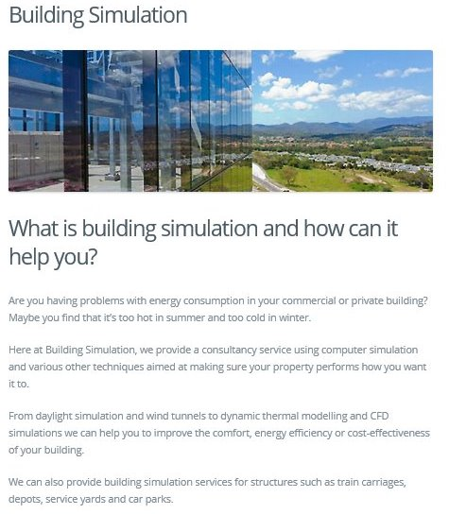
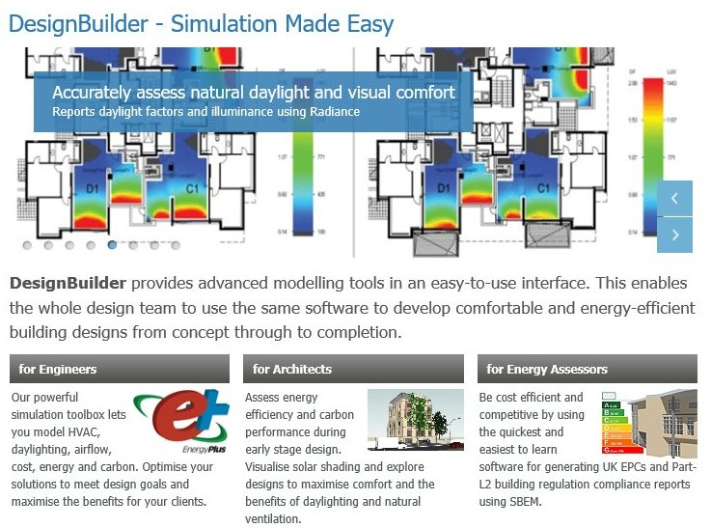
Building Simulation Software

Slide 16




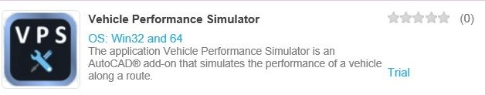
Examples of AutoCAD add-ins

Slide 17
A vision for the Future
Fire Engineering Guidelines

Slide 18
Do we share original vision?
1 | SCOPE AND GENERAL | Preliminaries
2 | MATERIALS AND COMPONENTS | Preliminaries
3 | BUILDING FIRE SAFETY SYSTEM REQUIREMENTS | Overall requirements
4 | BUILDING CHARACTERISATION | Overall requirements
5 | OCCUPANT CLASSIFICATION AND RATING | Overall requirements
6 | FIRE INITIATION AND DEVELOPMENT | Fire in enclosure of origin
7 | SPREAD OF SMOKE AND TOXIC PRODUCTS | Fire in other enclosures
8 | FLAME SPREAD | Fire in other enclosures
9 | OCCUPANT COMMUNICATION AND RESPONSE | Occupant reaction
10 | FIRE BRIGADE COMMUNICATION AND RESPONSE | Fire brigade intervention
11 | OCCUPANT AVOIDANCE | Occupant reaction
12 | CONSTRUCTION | Post design
13 | COMMISSIONING AND VERIFICATION | Post design
14 | OPERATION MAINTENANCE AND INSPECTION | Post design
15 | TESTING | Additional considerations
16 | EXISTING BUILDINGS | Additional considerations
Notes:
18

Slide 19
Some questions to answer
How do we focus on departures from dts?
Are the original sub-systems needed?
Degree of redundancy required?
What are appropriate design scenarios?
Is equivalence or more, required?
What are shortcomings of existing guidelines?
OH&S for fire fighters, provision for rescue?
What is acceptable risk for structural failure?

Slide 20
Perfect Risk Assessment Tool
What would it do?
How would it do it?
How would you use it?
What would be the inputs?
Where would you get the data?
What would be the outputs?
How would you verify it?
What documentation would you need?

Slide 21


What comes first?
OR
Guidelines
Risk Assessment Tool

Slide 22
Fire Engineering Methodology
Move from deterministic to probabilistic design
Greater emphasis on likelihood, reliability and risk
Underpinned by appropriate research program
Reliable risk simulation tools developed
Integrated into advanced CAD software
Calculators developed for Verification Methods
Societal Risk and F-N curves measure safety
Societal risk acceptance criteria:
  ALARP: design is within ALARP REGION
  Comparison to benchmark: RISK < REFERENCE
Notes:
22

Slide 23
Performance Benchmark
Should not have to reverse-engineer acceptable risk
A number of reference buildings analysed and harmonised in terms of risk
Benchmark buildings specified both in terms of risk and deterministic acceptance criteria
Acceptance of performance solution based on equivalence to relevant benchmark building
Credible design scenarios specified for reference buildings
More Verification Methods in NCC
Automated calculators for Verification Methods

Slide 24
ALARP and Societal Risk
Represents society’s acceptance of risk
Some risks more readily accepted – principally voluntarily accepted or high reward
Certain risks are too high and unacceptable
Certain risks are insignificant and do not warrant further risk mitigation
In between is tolerable range – risk should be
As
Low
As
Reasonably
Practical

Slide 25
F – N Curve
Risk deemed unacceptable
Slope:
  -1 Risk Neutral
  -2 Risk Averse
Risk deemed acceptably safe
1
2
Unacceptable
3
Tolerable (ALARP)
Acceptable

Slide 26
What can the Society for Fire Safety Do?
Define ALARP acceptance criteria for buildings
Define a range of Reference Buildings for comparison
Collate reliability data for fire safety systems to Australian Standards
Sponsor development of risk-based FSE Code
Promote vision among external stakeholders

Slide 27
Turning a Vision into Reality
Share the vision!
Expound the virtues of the change
Justification of the necessary expenditure in terms of future benefits – microeconomic reform
Develop a clear road map
Work with the pioneers and encourage early adopters
Education and research required to underpin change
Above all – DO SOMETHING!
Notes:
27

Slide 28




Stephen’s Ball

Slide 29
Thank you!
Questions?

