Slide 1
Performance Based Design of Exposed Mass Timber
The Macallan Distillery, Easter Elchies
Items to Consider
Robert Dixon – robert.dixon@arup.com

Slide 2
The Macallan Distillery, Easter Elchies
Contents
Mass Timber
Design Intent
Technical Challenges
Fire Resistance Levels
Self-extinguishment
Delamination
Adhesives
Connections
Non-Technical Challenges
Design Tools Available
New Eurocode 5
Some Performance Based Watch-its
Practical Design Measures

Slide 3
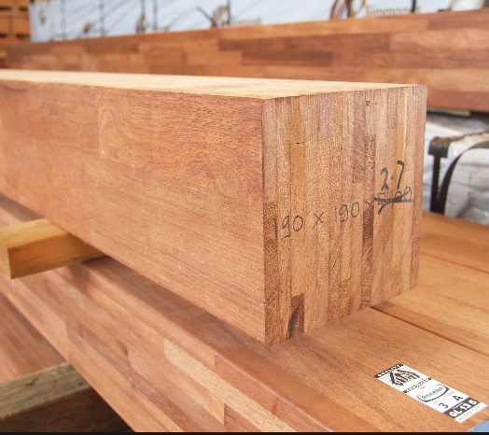
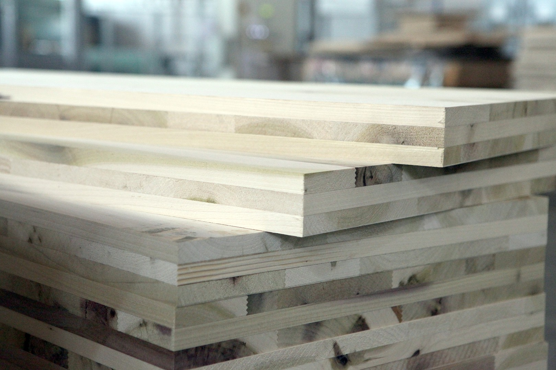
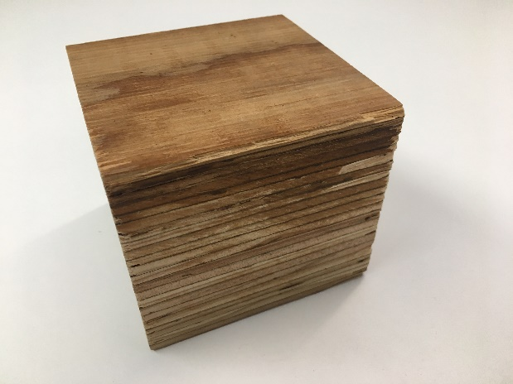
The Macallan Distillery, Easter Elchies
Mass Timber
Glulam – Glued Laminated Timber
comprises of a number of layers of timber bonded together with a moisture resistant adhesive or glue. Multiple smaller pieces are glued together to make one large strong beam.
Beams/columns
CLT – Cross Laminated Timber
layers of timber, known as lamellas, are glued together with the grain alternating at 90 degree angles for each layer.
Panels/slabs of timber
LVL – Lumber Veneer Lumber
manufactured by bonding together rotary peeled or sliced thin wood veneers under heat and pressure
Beams/columns/cassettes

Slide 4
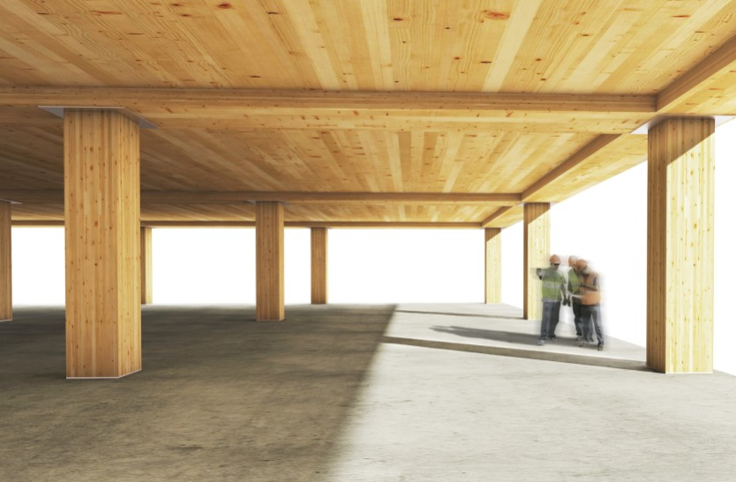
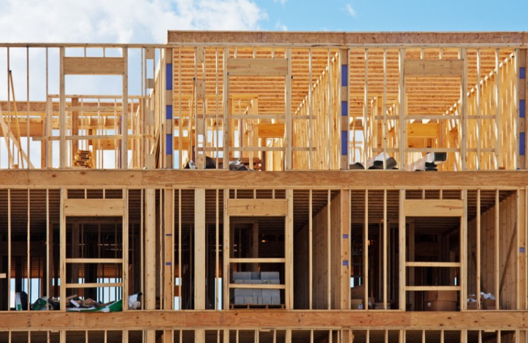
The Macallan Distillery, Easter Elchies
Mass Timber
Rather than…

Slide 5
The Macallan Distillery, Easter Elchies
Design Intent - What Does the Design Need to Achieve?
Architectural Intent - Exposed / Encapsulated / Both
Low-Rise
Accepted that a low rise building may be lost in a fire.
Mid-Rise
Maybe acceptable to lose in a fire, if occupant can escape and there is a demonstrated period for fire brigade intervention.
Risk
High-Rise
Occupants may be required to remain in the building.
Occupants may be above fire floor.
Takes fire brigade longer to intervene.
Structure must survive burn-out.

Slide 6
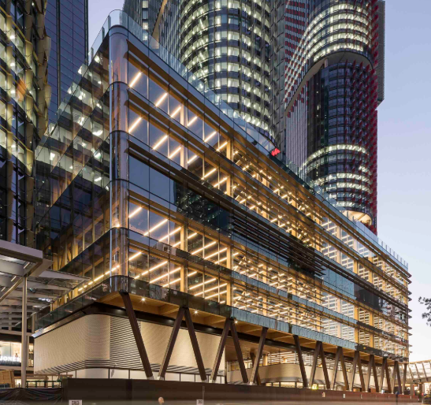
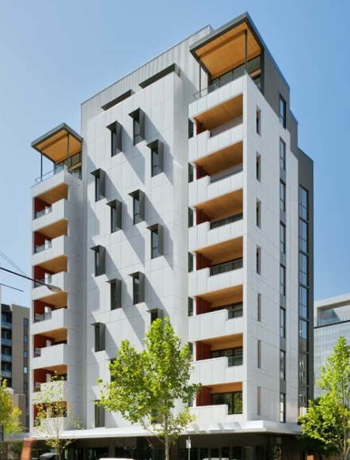
The Macallan Distillery, Easter Elchies
Technical Challenges
Timber Timeline
Risk
(height, exposure, use)
Fully exposed.
<25m
Fully exposed.
>25m
Fully encapsulated.
Time
2013
2017
2018

Slide 7
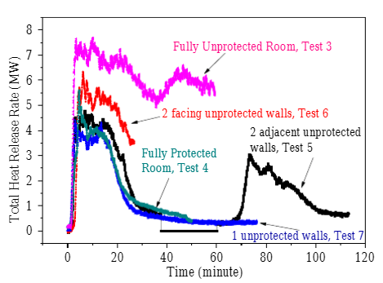
The Macallan Distillery, Easter Elchies
Technical Challenges
Fire Resistance Levels (global)
Is it reasonable to add fire load, and remove fire resistance?
Traditional time equivalence not applicable.
Structure contributes to fuel.

Slide 8
The Macallan Distillery, Easter Elchies
Technical Challenges
Fire Resistance Levels (global)
More exposed timber, more fuel, longer duration.
Delaminating CLT, fire re-growth, unpredictable.
Higher required FRL.

Slide 9
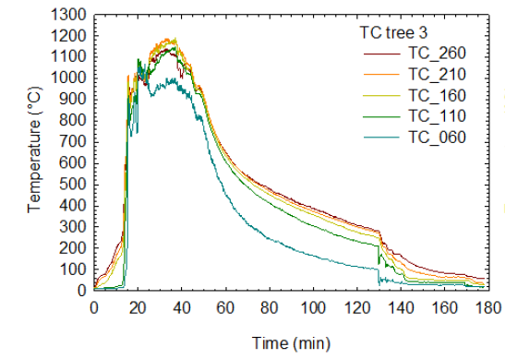
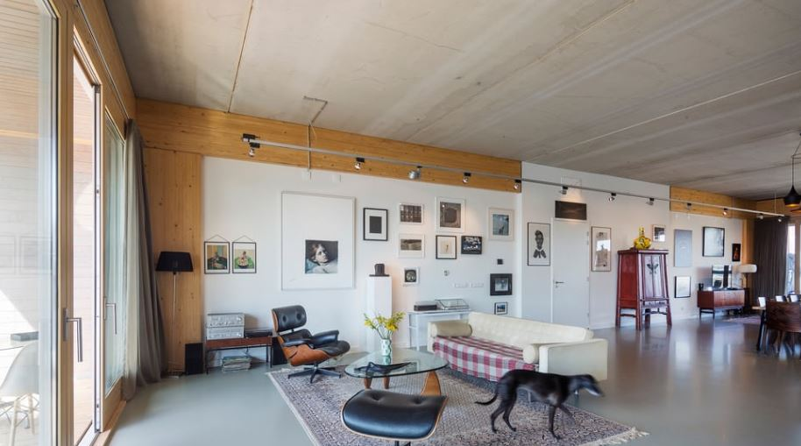
Technical Challenges
Fire Modelling – Exposed timber
Fuel load 500MJ/m²

Slide 10
Technical Challenges
Fire Modelling – Exposed timber
Fuel load 750MJ/m²

Slide 11
Technical Challenges
Fire Modelling – Exposed timber
Fuel load 1100MJ/m²

Slide 12
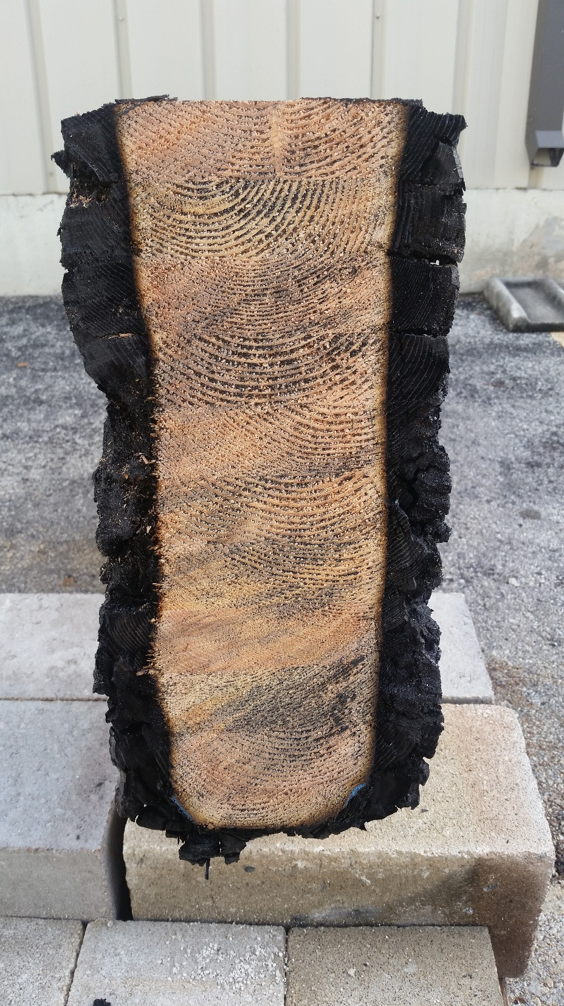
The Macallan Distillery, Easter Elchies
Technical Challenges
Fire Resistance Level (element)
Fire Resistance = Char Rate x Exposure Time
What is exposure time?
Complete burnout in a high rise building.
Burn duration increases with amount of exposed timber.
What is char rate?
Building specific.
Timber specific.
Exposure specific.
Applicability of standard fire tests for timber elements.

Slide 13
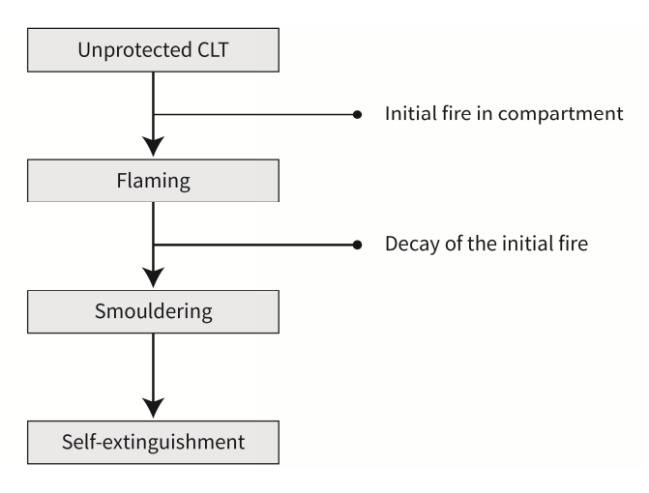
The Macallan Distillery, Easter Elchies
Technical Challenges
Self-Extinguishment
Very influential factor in exposed timber design.

Slide 14
The Macallan Distillery, Easter Elchies
Technical Challenges
Self-Extinguishment
Large variability design values applied;
University of Queensland (Emberley et al.) - 45kW/m²
Delft University (Crielaard) - 6kW/m²
Has a huge impact on the design;
Fire duration, delamination, size and intensity of fire, char rates.
Fire Resistance Level.
How compatible are the tests to a specific building?
Fuel load, ventilation, surface air flow, compartment size.

Slide 15
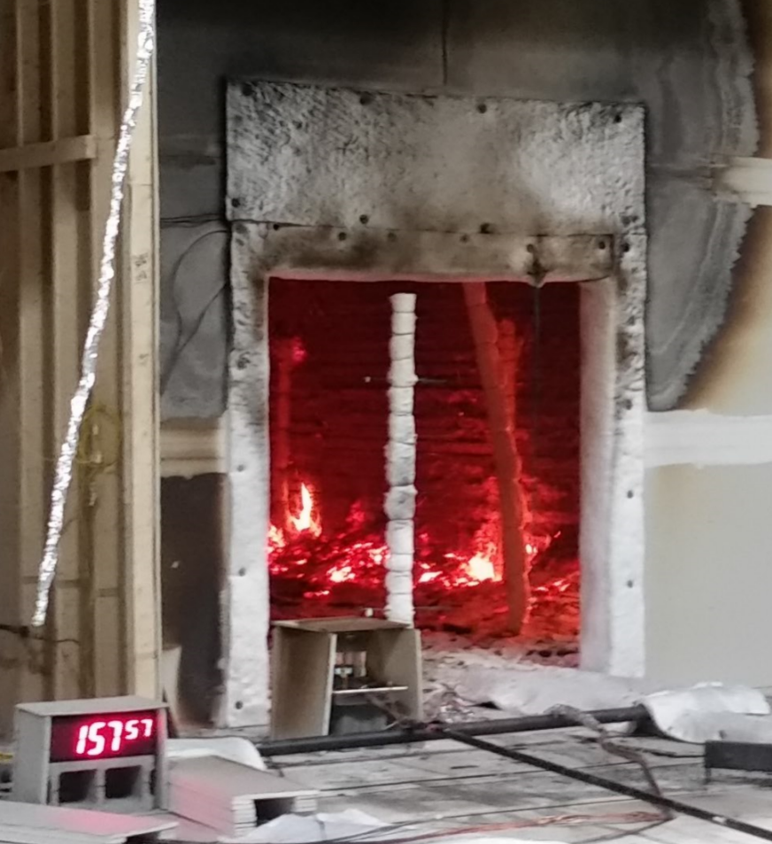
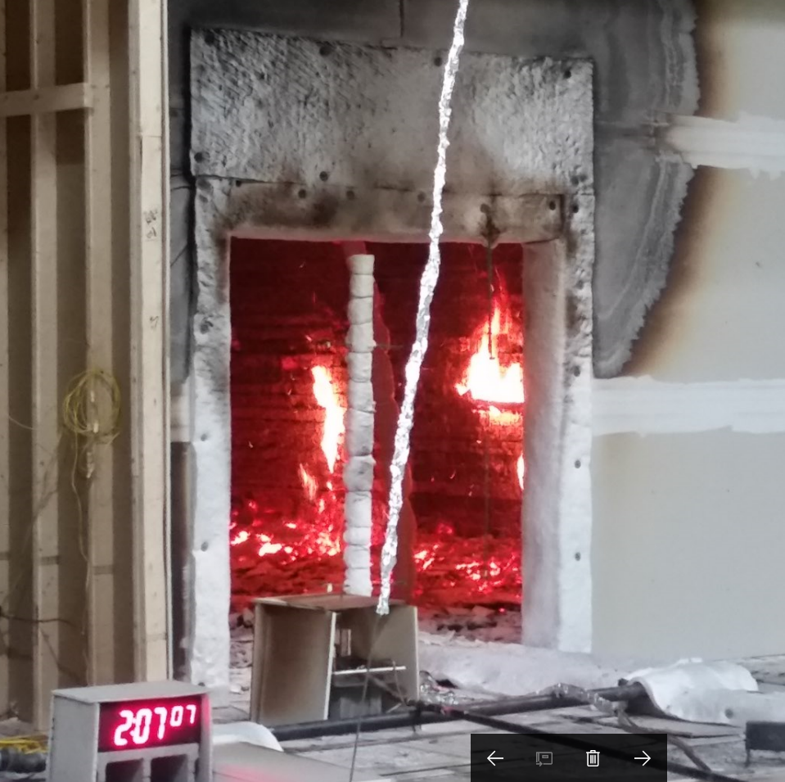
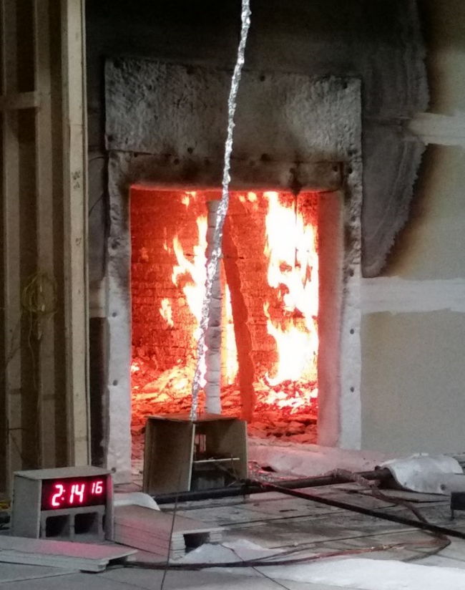
The Macallan Distillery, Easter Elchies
Technical Challenges
Delamination (char fall-off)
Inhibits self-extinguishment. Promotes fire re-growth
Influences duration, char rate and Fire Resistance Level
FPRF tests; single wall exposure

Slide 16
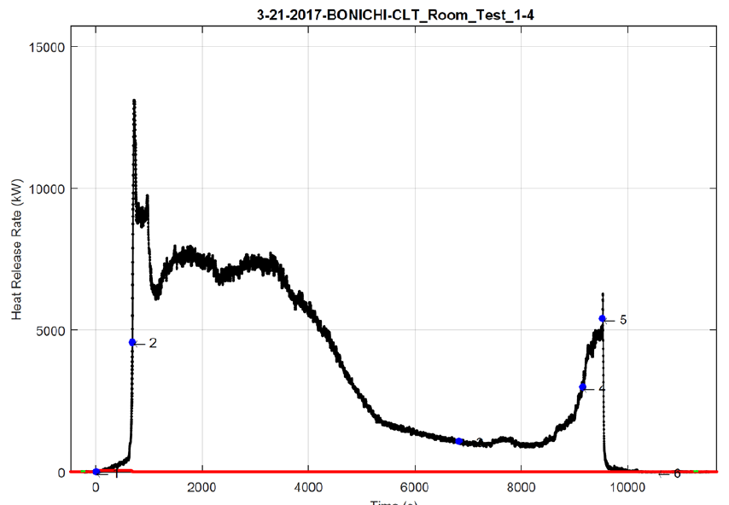
Technical Challenges
Delamination – Fire re-growth
Fire Protection Research Foundation (NRCC and SP), Test at NIST: Test 1-4

Slide 17
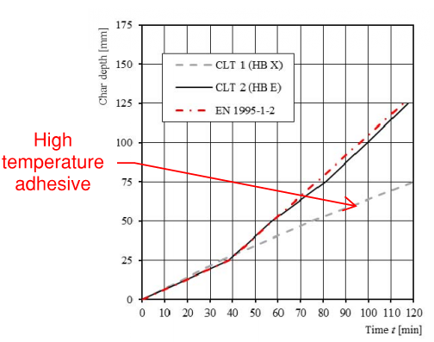
The Macallan Distillery, Easter Elchies
Technical Challenges
Adhesives (CLT)
Choice of adhesive impact fire performance of CLT.
High temperature adhesives can reduce / eliminate delamination.

Slide 18
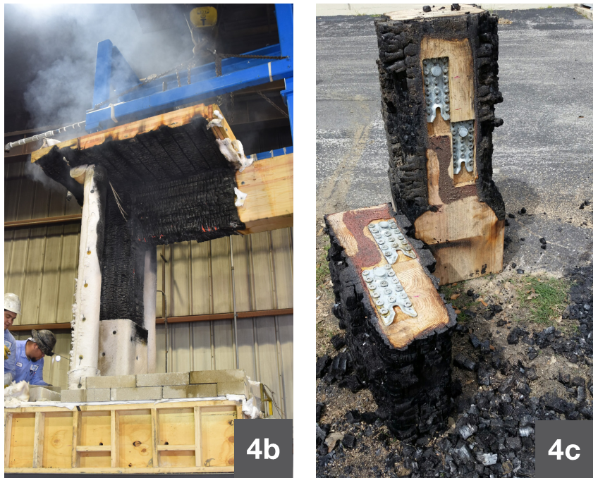
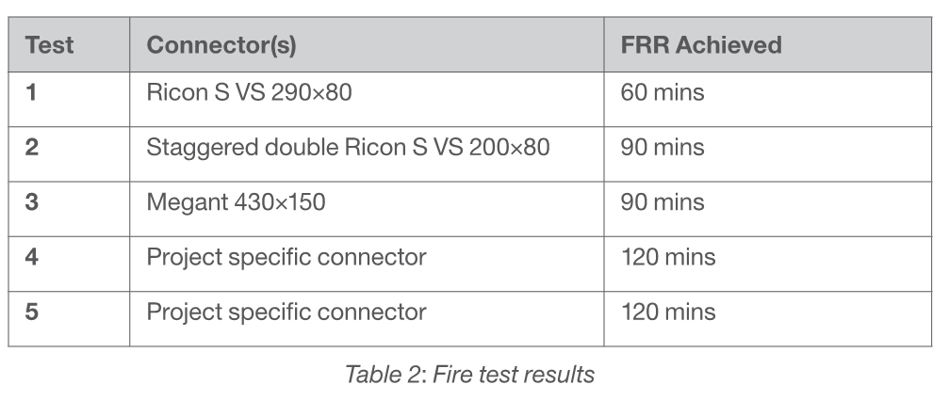
The Macallan Distillery, Easter Elchies
Technical Challenges
Connections
Connections should undergo a loaded fire test.
Otherwise sophisticated analytical approach required.
Increased charring at connections.
Not all fire tests are loaded.

Slide 19
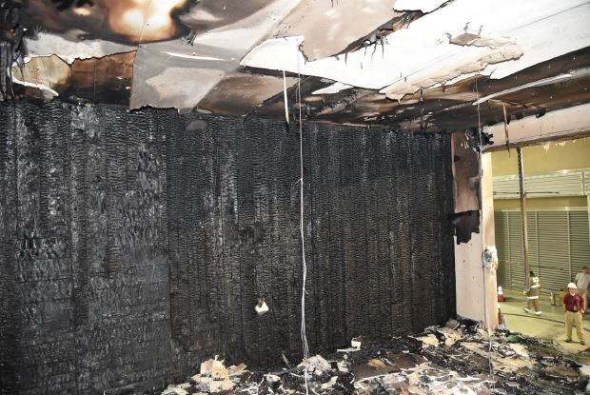
The Macallan Distillery, Easter Elchies
Technical Challenges
Encapsulation Failure
If timber is not encapsulated or protected properly, then elements becomes exposed.
Elements behind failed encapsulation may not be designed to char.
Encapsulation failure can be encompassed within the system design, underpinned by compatible test data.
Image from: Zelinka, Samuel L.; Hasburgh, Laura E.; Bourne, Keith J.; Tucholski, David R.; Ouellette, Jason P. (In press). Compartment fire testing of a two-story cross laminated timber (CLT) building. General Technical Report FPL-GTR-247. Madison, WI: U.S. Department of Agriculture, Forest Service, Forest Products Laboratory.

Slide 20
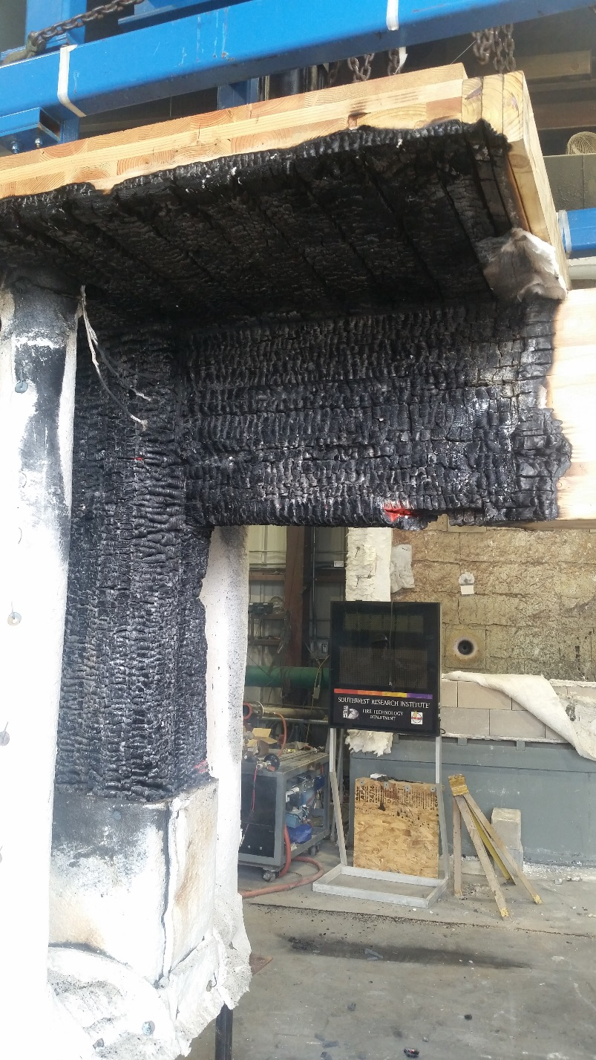
The Macallan Distillery, Easter Elchies
Non-Technical Challenges
Testing vs Analysis
Fire engineers need to be aware of the risk they are taking on when undertaking non-validated analysis.
Often there is pressure to undertake assessment in lieu of testing.
Much of our work is outside (or beyond) the scope of codes.

Slide 21
The Macallan Distillery, Easter Elchies
Non-Technical Challenges
Early Fire Engineering Input Required
Due to procurement process, structural elements need to be fully designed much earlier in the project cycle.
Early engagement with architect, structures, acoustics and building services is key to project success.
Testing schedule should be defined early as to not impact program.

Slide 22
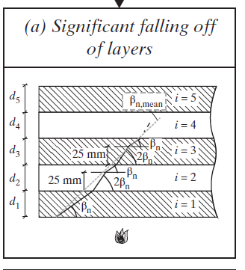
The Macallan Distillery, Easter Elchies
Design Tools - Char Model for Delaminating CLT
Pros
Offers methodology to determine element FRL for delaminating CLT (not previously available).
Quick, easy to use.
Solid theoretical basis.
Cons
Relies on initial nominal char rate input.
Not embodied in a current code.
Eurocode 5 proposed method
(From "Design of Cross-Laminated Timber in Fire", by Klippel and Schmid, ETH)

Slide 23
The Macallan Distillery, Easter Elchies
Design Tools - Parametric Fire Curves
Cons
Only applicable to smaller compartments.
Difficult to allow for char fall-off.
Limited validation.
Pros
Quick, inexpensive.
Accepted within academic community and approval authorities.
Can be used to determine FRL and burn duration.

Slide 24
The Macallan Distillery, Easter Elchies
Design Tools - FDS / Pyrolysis Simulation
Cons
Very time consuming.
Computationally expensive.
No validation for large scale (e.g. open plan compartments).
Can be costly.
More suited to research at the moment.
Pros
Accurate representation of timber burning characteristics.
Large compartment application.
Good validation for small (cone calorimeter) and medium scale (room tests).

Slide 25
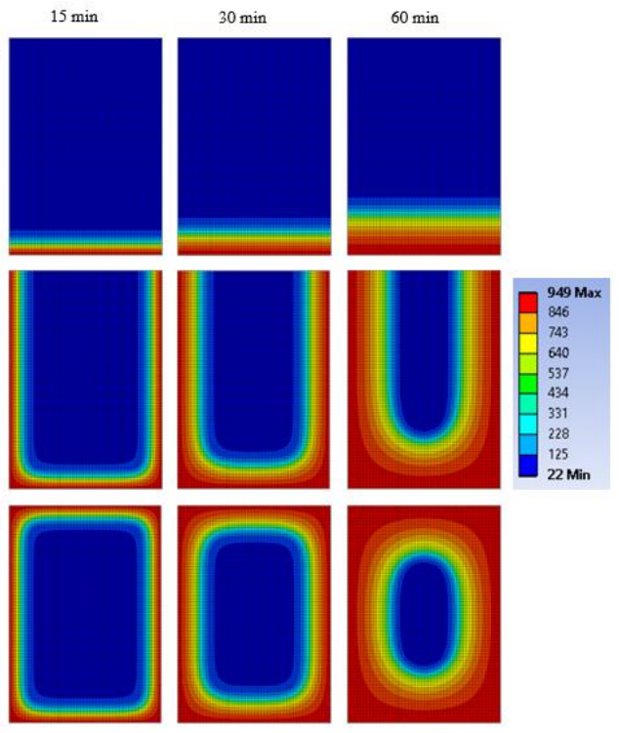
The Macallan Distillery, Easter Elchies
Design Tools – Finite Element Modelling
Pros
Potentially accurate representation of heat transfer through timber.
Can be used to determine loadbearing capacity of elements, connections or frames.
Cons
Timber material models can be very complex.
Significant and potentially complex validation required.
Computationally expensive.
Costly.

Slide 26
The Macallan Distillery, Easter Elchies
New Eurocode 5 (BS EN 1995-1-2)
Currently out for public review. Revision includes;
Improved charring and ‘effective cross section’ models.
Simplified calculation for failure of plasterboards included.
CLT is covered more specifically.
Improved design rules for connections, now up to 90 mins.
Still to be developed;
Testing standards for insulation and glue performance.

Slide 27
The Macallan Distillery, Easter Elchies
Performance Based Watch-its
Fire testing and fire dynamics has shown that more exposed timber – more fuel, longer fire, higher char rates, higher required Fire Resistance.
Delaminating CLT – regrowth can lead to a very long and unpredictable fire. Adhesive dependent. CLT can only be designed to have predictable compartment response if the adhesives does not cause delamination.
No validation for fire dynamics within a large compartment containing exposed timber surfaces.
Research and test data should be used in the correct context e.g. UQ self-extinguishment demonstration should not be used as the basis for building design.
Undertake analytical assessments with caution.

Slide 28
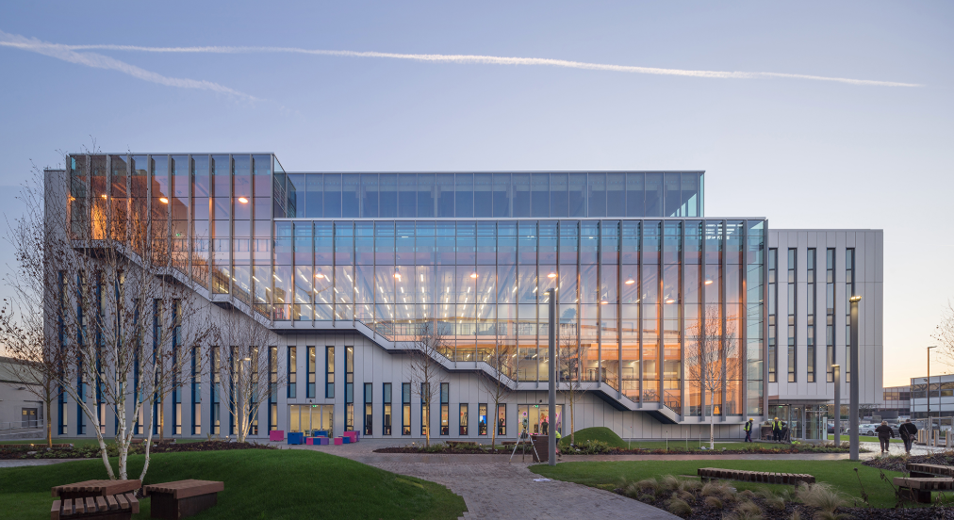
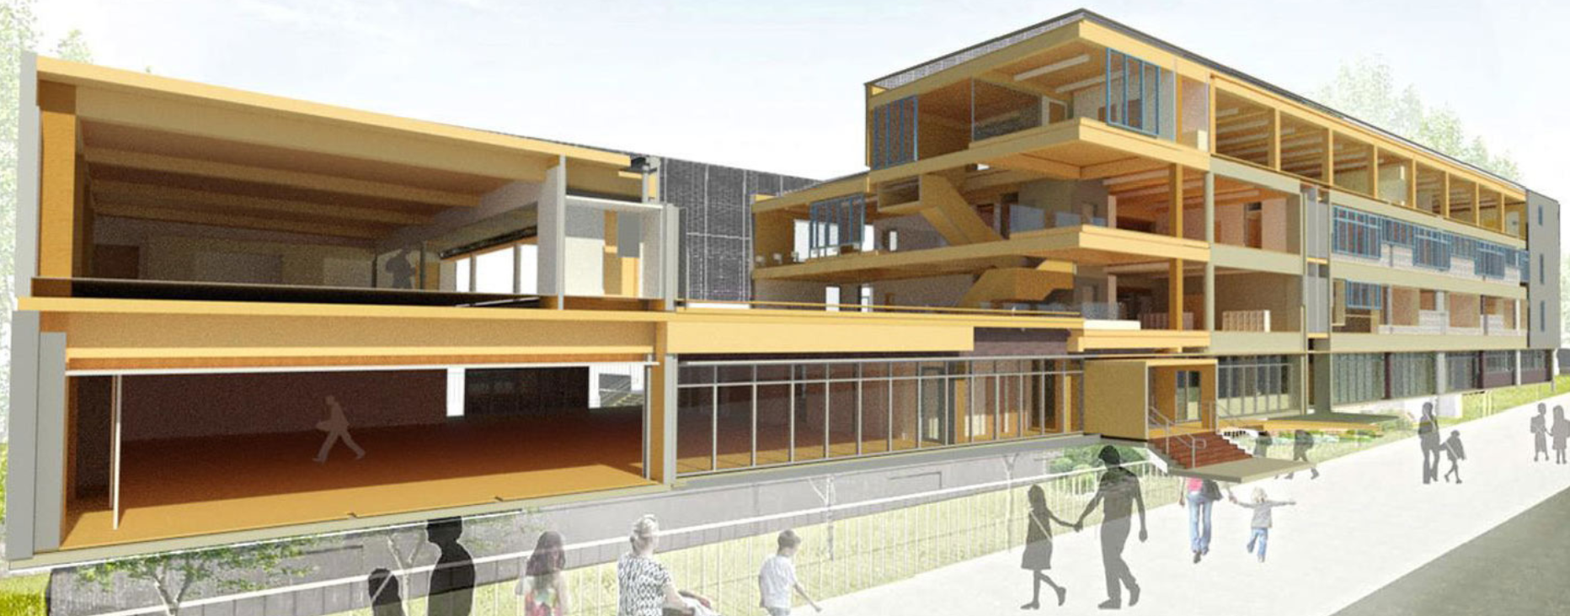
The Macallan Distillery, Easter Elchies
Practical Design Measures
Consider amount and location exposed timber.
High temperature / PUR adhesives for CLT.
Thick exposed lamella for CLT.
Configure compartments for favourable ventilation conditions.
Holistic design (e.g. improved sprinkler reliability / egress systems etc.)
Project specific testing.

Slide 29
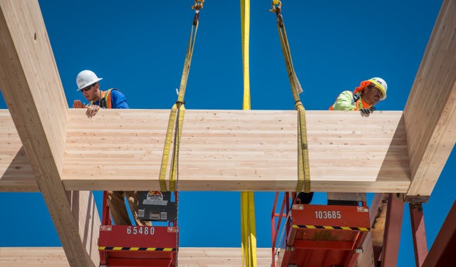
Thank you
The Macallan Distillery, Easter Elchies

