Slide 1
Fire performance of structures
John Hewitt

Slide 2
Structures and Fire
Structural design
Structural engineers, Fire engineers
Concepts for structural assessment in Fire
Fire severity
  Time equivalence
  Other approaches
  Comparisons

Slide 3
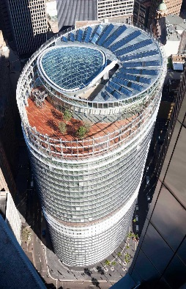
Structural Design

Slide 4
Structural Design
Loads are relatively well understood and/or defined in standards
Loads are subject to factors of safety
Expected strengths and member capacities are reduced by factors
All structural materials are tested
Each structural member is specifically designed for forces upon it, taking into account its role in the overall structure
Structural engineers understand ‘load paths’ and how every force can be resisted and transferred to the ground

Slide 5
Structural design
… but there are many uncertainties
Dead loads, live loads, wind loads
Seismic and fire – analogy – extreme cases
Both push the structural performance beyond normal limits, allowing yield, and damage to occur
In seismic design, very important to understand the structural performance, dynamics, non-linear behaviour etc
Need similar understanding in a structural fire case to check that performance will be achieved

Slide 6
Structural Performance in fire – ideal performance:
For buildings that would require Type A construction:
No collapse of main structure, with full burn out
No breach of compartmentation
Usually no active systems or intervention assumed

Slide 7
Do structural engineers understand fire?
Fire is not usually part of a structural engineers training (we are working on this!)
FRL, fire severity, not understood fully or not at all
BCA is rarely looked at
But on being told a required FRL, structural designers will apply code rules for concrete dimensions, cover etc
Loading standards specify a ‘Fire Load case’, ie a reduced vertical load to be supported in the case of a fire.
For steel, can work out a ‘critical temperature’, for single elements.
Fire performance of whole structure needs specialised knowledge

Slide 8
Do fire engineers understand structures?
??
Conclusion: In assessing fire performance of structures, there are gaps in the usual understanding of the main players

Slide 9
Concepts for structural fire performance

Slide 10
Structural Performance in fire – ideal performance:
For buildings that would require Type A construction:
No collapse of main structure, with full burn out
No breach of compartmentation
Usually no active systems or intervention assumed

Slide 11
Fire Protection for single steel elements
How hot can the steel be allowed to reach, and still carry prescribed loads?
How long must it remain below this temperature ie what is the required FRL?
What protection is required to do this?

Slide 12
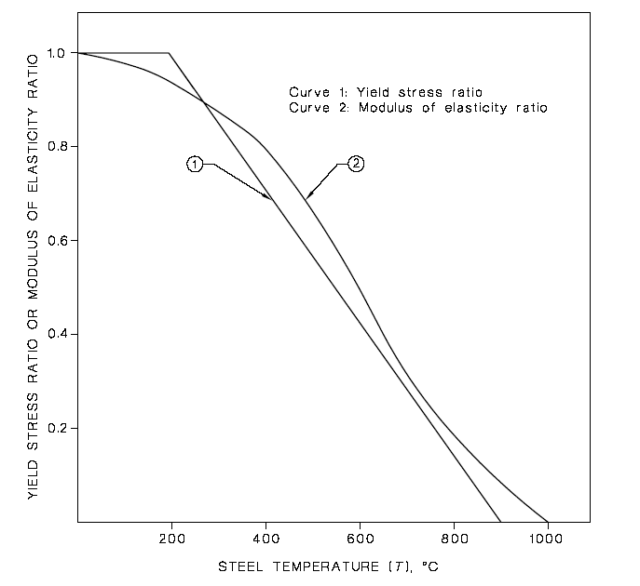
Steel - Reduction in strength and stiffness

Slide 13
Load Cases – AS 1170.0
Normal Load case 1.2 Dead + 1.5 Live
Fire Load case 1.0 Dead + 0.4 or 0.7Live
Load factors reduced
eg If dead = Live
If 90% utilization for NLC
r = 0.9x FLC/NLC = 0.9 x 1.4/2.7 = 0.47
Tcrit = 905-690r
Critical temperature = 583ºC

Slide 14
Critical Temperature
550 C often used as a criterion for fire protection materials
But Critical temperature could be less – eg if mostly dead load
Or could be more, eg if structure has spare strength under normal loads
So need to check it

Slide 15
How quickly does steel heat up?
Depends on:
Gas temperature
Exposed area
Thermal Inertia
Insulation

Slide 16
K_{sm} Concept
Exposed surface area to mass ratio m²/tonne
Some codes use Heated Perimeter/Area H_{p}/A
  (deals with the same thing)
High K_{sm} Low K_{sm}
heats quickly heats slowly

Slide 17
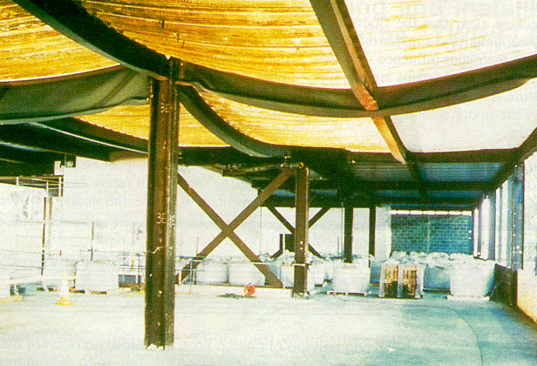
Composite construction – interaction of elements
For composite construction:
Some secondary beams left unprotected
Columns and their connections should be protected
Floor slab is key to increased strength in fire conditions
Detailed numerical models
Notes:
• Secondary beams can be left unprotected.
• Unprotected beams can survive even if sprinklers do not operate.
• Perimeter beams are relatively unheated in compartment fires and this should be considered when providing fire protection.
• Columns should be protected to their full height and should include the connection.
• The importance of composite floor slabs in maintaining structural stability will be emphasised. It is felt that this issue is the key to the strength observed in overall frame behaviour in fire. In particular, the development of tensile membrane action in the composite slab and its significance in maintaining the strength and stability of the structure even where large displacements occur.
MENTION SCI GUIDE FOR 60 MINUTE ASSEMBLIES ETC ETC COLIN BAILEY TO ALLOW SECONDARY BEAMS TO BE UNPROTECTED

Slide 18
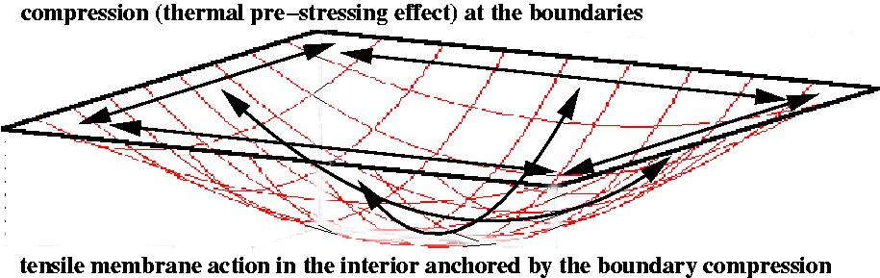
Importance of the slab
Anchoring tensile membrane action around the perimeter edge of the slab
Composite edge beams
Anchoring reinforcing mesh

Slide 19
Heron Tower
Compartment floor
Typical Village
Atrium
floors

Slide 20
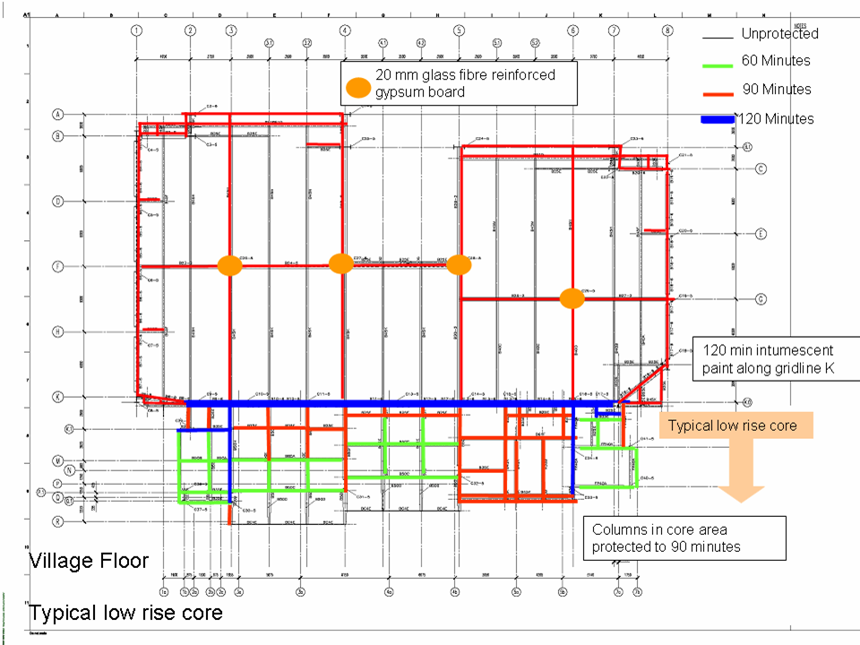
Design fire protection layout

Slide 21
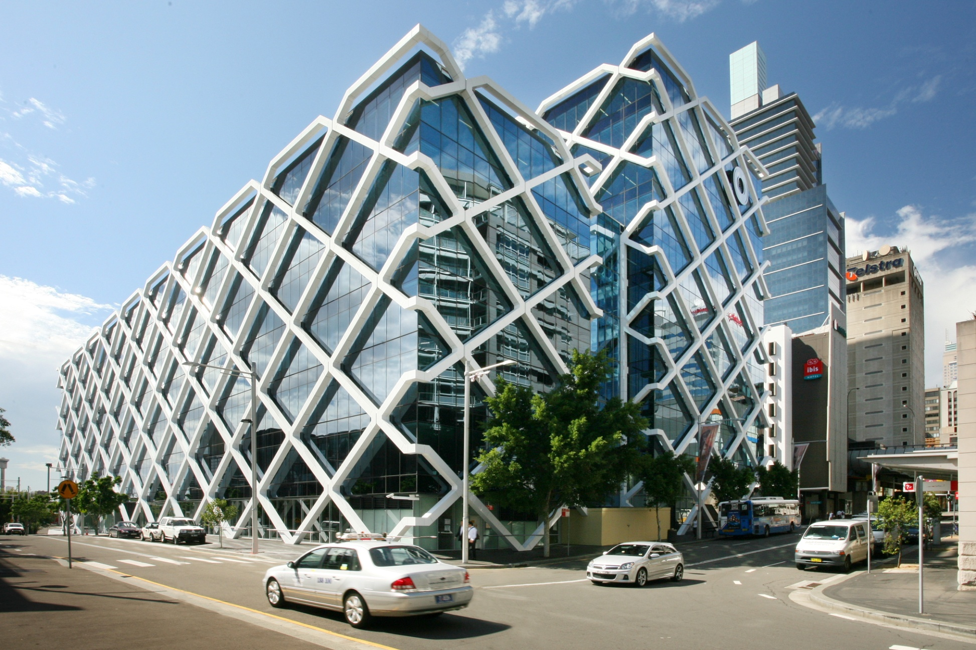
One Shelley Street

Slide 22
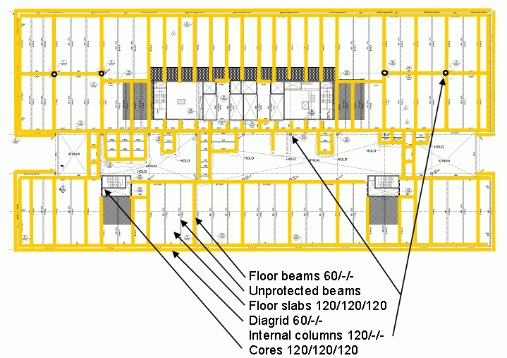
One Shelley Street

Slide 23
Material Response - Timber
Calculate the strength based on what’s left
Charring and heat affected zone, deeper with time, insulates inner timber
Eg 0.7mm/min +7.5 mm

Slide 24
Material Response - Concrete
Heat transfer to other side – fire separation
Heat transfer to steel
Concrete degrades, may spall

Slide 25
Fire Severity

Slide 26
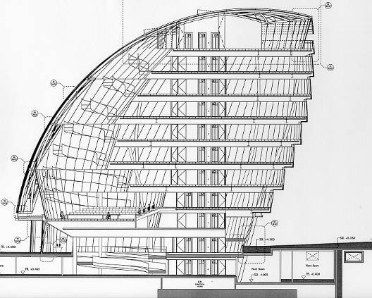
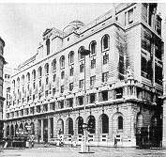
Time-Equivalent Analysis
The more ventilation the lower the temperature so a lower rating possible
Ventilation - 60 v’s 120 minutes
Notes:
Arup Fire conducted a study of time equivalence on a modern building with extensive glazed façade and compared that to the time equivalence of a traditional early 19th century office with a façade typical of the style when the fire resistance test was developed and prescriptive fire resistance guidance was written.
The time equivalence calculation for the traditional office agreed with the prescriptive guidance for an office building of that height.
The modern building only required half that value because the fire is so much less severe when there is so much ventilation.

Slide 27
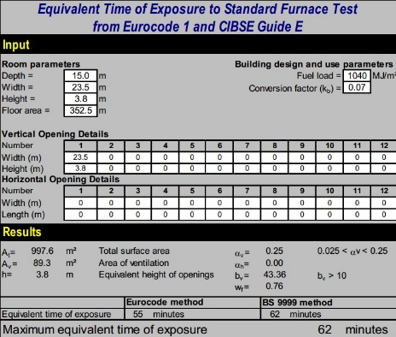
Fire severity – time equivalence calculation

Slide 28
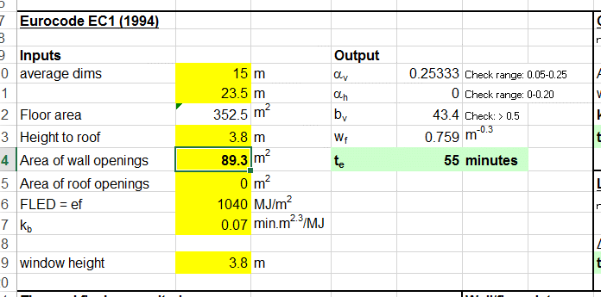
Fire severity – time equivalence calculation

Slide 29
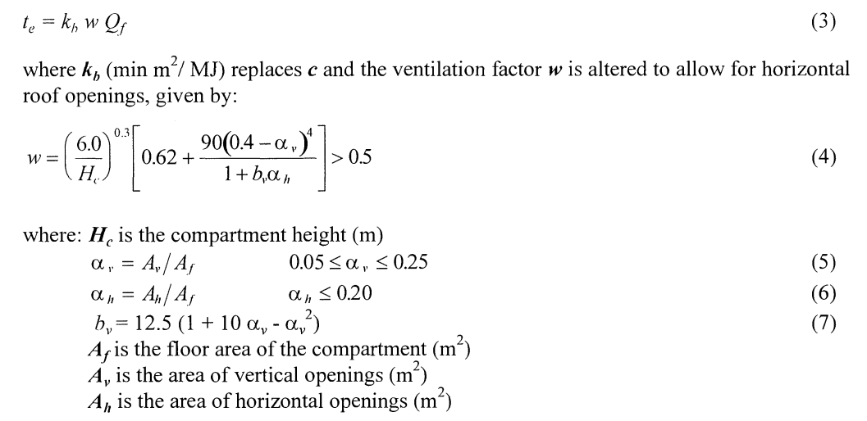
Time equivalence – Eurocode formula

Slide 30
Time equivalence calculations – pros and cons
Pros
Recognises effect of fuel load, ventilation, compartment dimensions and boundary conditions
Simple to calculate, simple to use the result
Cons
Black box calculation
Does not convey understanding of the nature of the fire
Cannot separate short/hot fires from longer cooler fires
Does not understand different structures, different critical temperatures, different structural performance
Developed for protected steelwork, not concrete, timber, insulation issues etc

Slide 31
A more rigorous approach

Slide 32
Time temperature model
    Parametric fire
    CFD calc
    Test measurements
Heat transfer model
    Radiation, convection, conduction
    1-dimensional – lumped mass
    2-d or 3-d heat transfer – finite elements
    Thermal properties constant or vary with time/temp
Structural model
    Single element strength v temperature
    Interaction with whole building

Slide 33
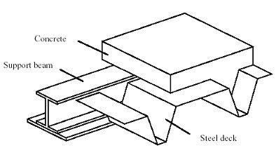
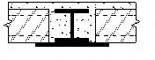
‘Slimflor’ system

Slide 34
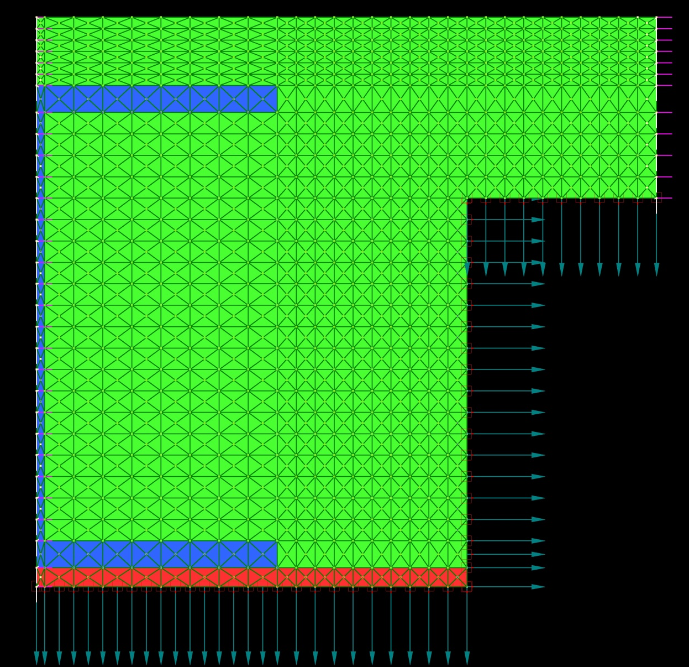
Finite Element Model

Slide 35
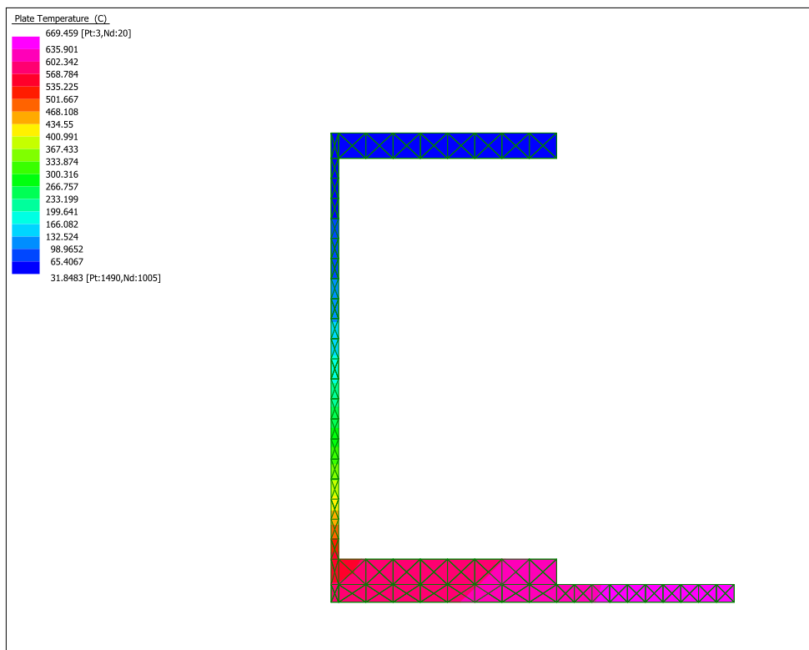
Temperature and strength at 60 minutes
Upper flange, 100⁰
Strength 100%
Lower flange, 600⁰
Strength 40% approx
Overall plastic moment capacity, x 80% approx

Slide 36
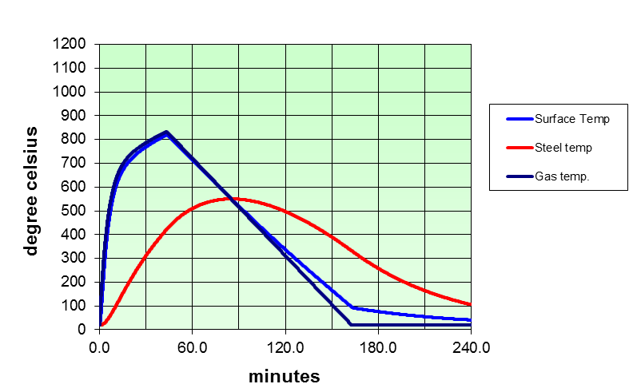
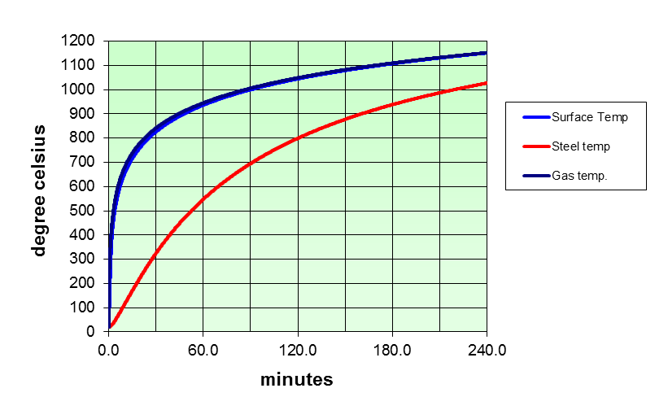
1 dimensional assessment
Protected steelwork – specific sections
Time in a standard fire to cause same reduction in strength as predicted actual fire
Critical temperature
FIRE!

Slide 37
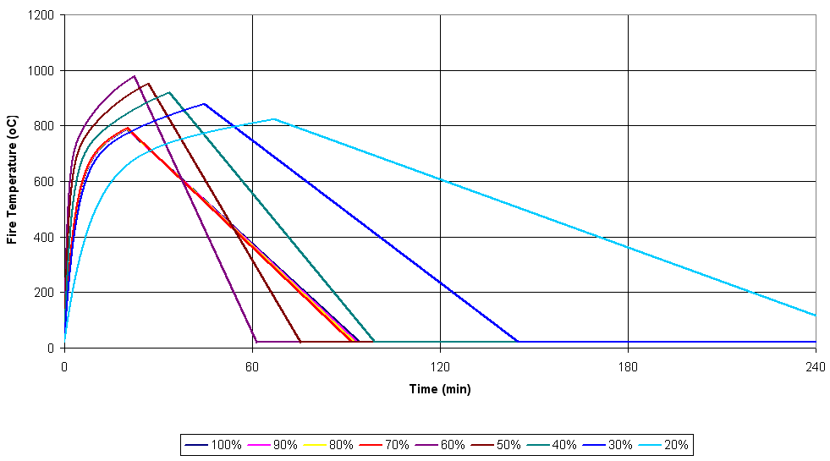
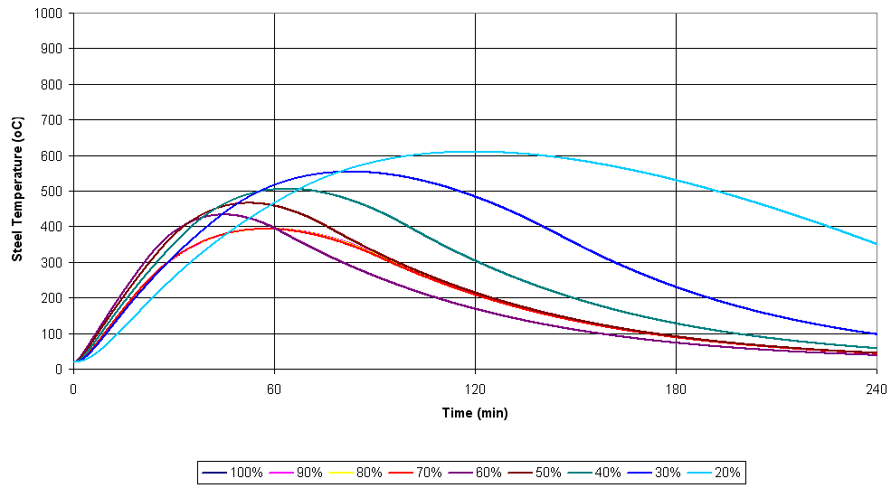
The effect of ventilation

Slide 38

Comparison case – 60 minutes equivalent FRL

Slide 39
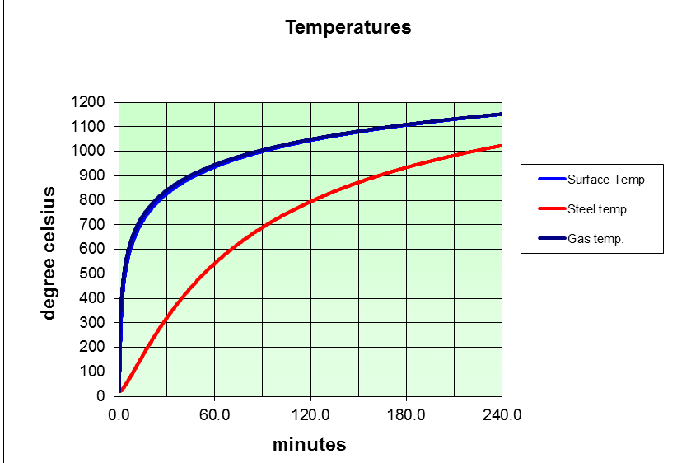
Test case 60 FRL – compare using parametric fire, simple 1d heat transfer
410 x 60kg/m Universal beam, with fire protection for 60 FRL, 19mm insulation, critical temperature 550C

Slide 40
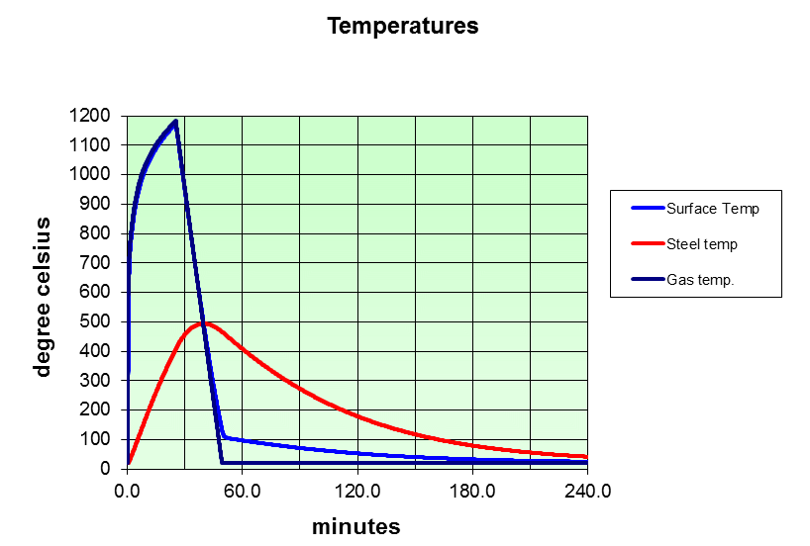
Parametric fire curve generated from same room/fuel data
410UB with protection FRL60, max temp = 493ºC < Tcrit

Slide 41
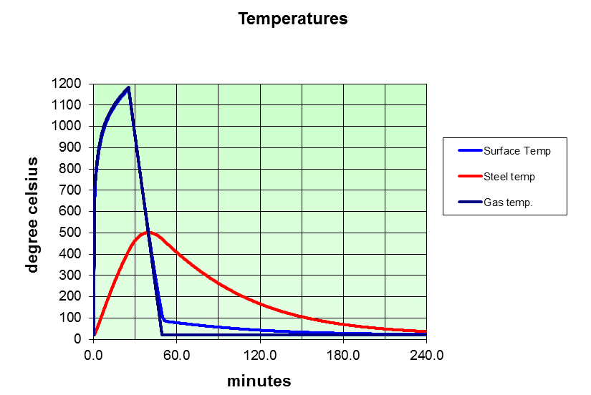
How about a much smaller steel section?
150 UB14 FRL60, 27mm insulation, max temperature 502C

Slide 42
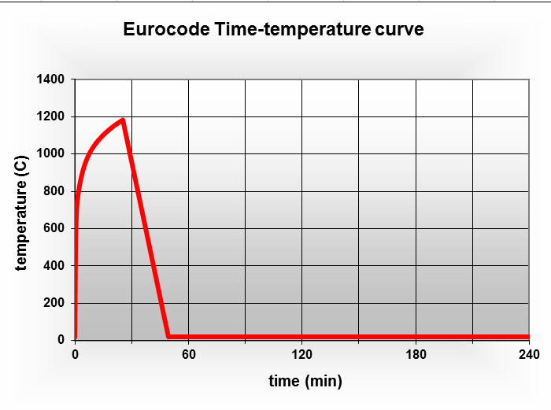
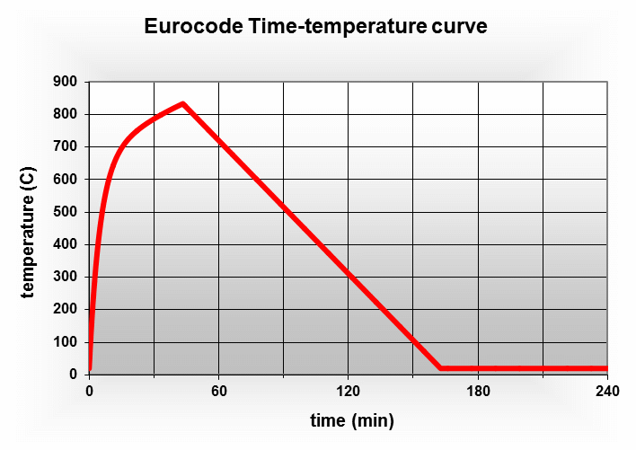
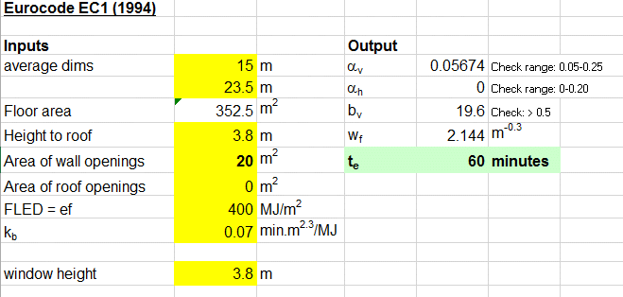
Hot and fast or longer slower fire?

Slide 43
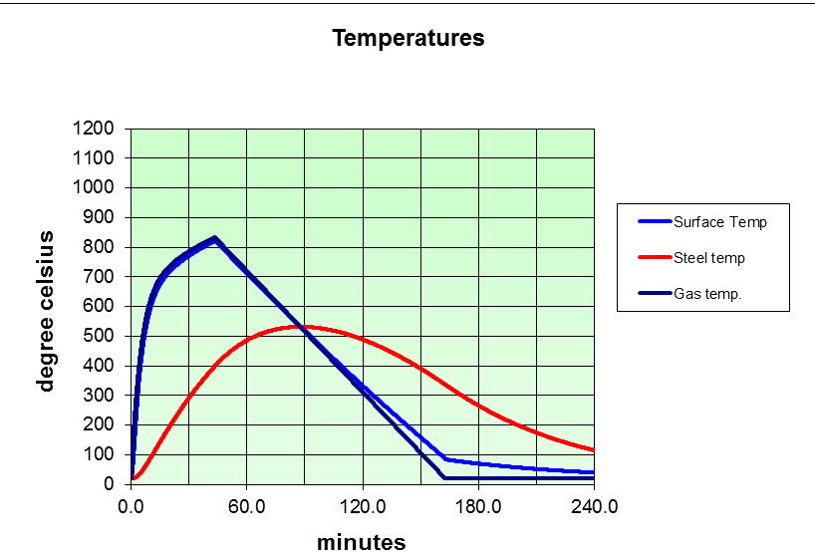
Long slow fire
410UB, long slow fire with T equiv = 60 min, max temp = 532ºC

Slide 44
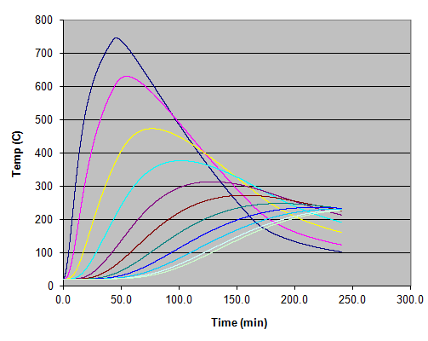
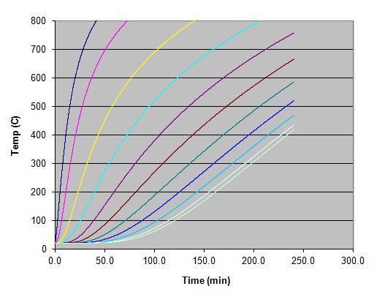
400 dia concrete column
Parametric fire ISO fire
Based on Tequiv 60min
Outer surface
Inner core

Slide 45
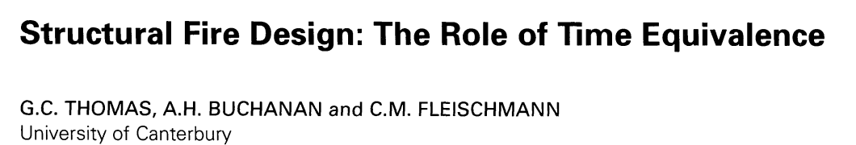

Slide 46
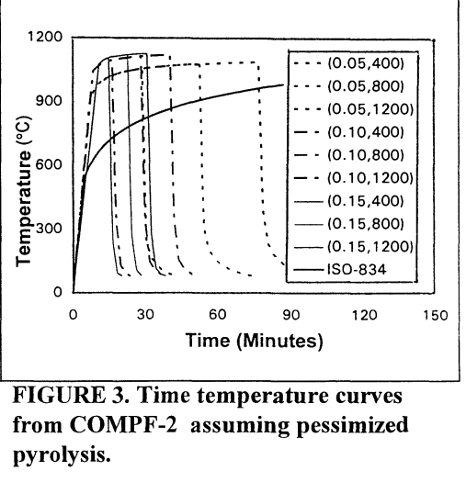
Thomas, Buchanan & Fleischmann

Slide 47
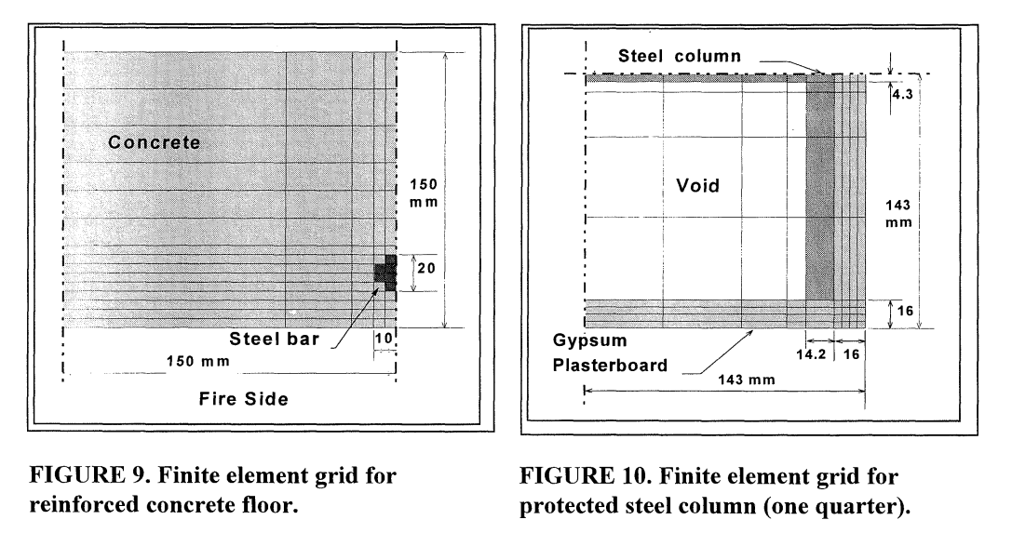
Thomas, Buchanan & Fleischmann

Slide 48
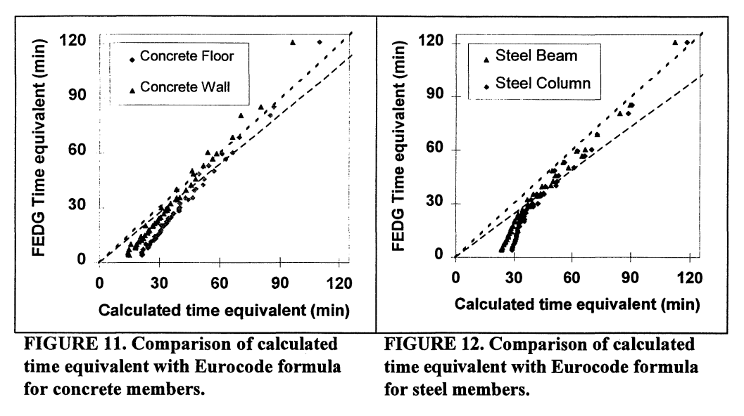
Thomas, Buchanan & Fleischmann

Slide 49
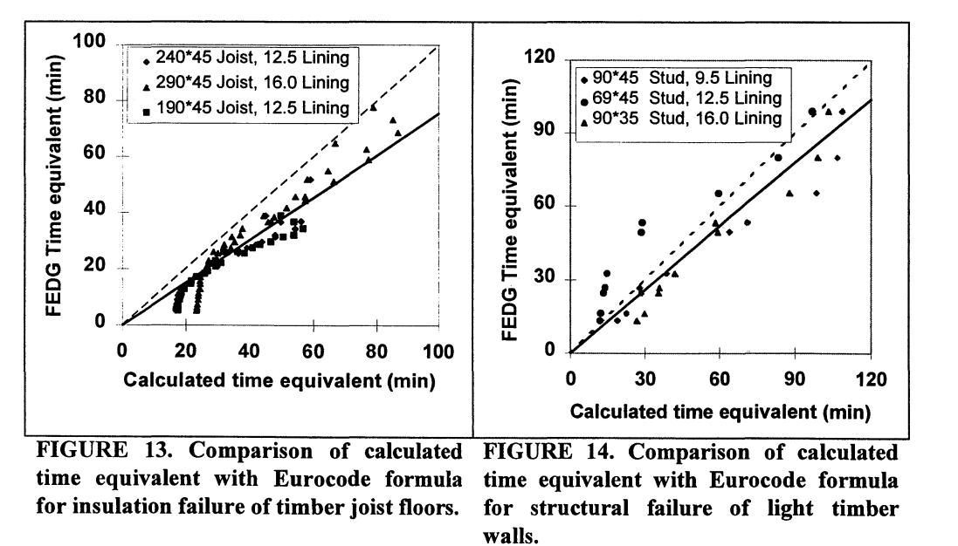
Thomas, Buchanan & Fleischmann

Slide 50
Fire Severity - Summary
Time equivalence calcs can be useful, but care needed to apply only when valid
T equiv not useful for detailed structural fire assessment beyond applying FRL
Concerns in a number of cases, eg short fires, cases other than protected steel structure
More rigorous approach is possible, even with the same input data, that can provide better insight into performance and uses specific properties of the structure

